Slide 1
go:Meili Presentation 8
31/10/210

Slide 2
Contents
This week's recap
Software
Hardware
Track
Next week

Slide 3
This week's recap
Individual questions:
Things that were improved?
Problems that we found?
Challenges for the next week?
Group discussion:
Are there any questions or gaps regarding what happened the previous weeks or the status of our team (tools, meetings, achievements)?

Slide 4
Software
Added 20 more horizontal lines to the Lane Following Algorithm in order to get more input data.
Experimented with changing the number of horizontal lines
reducing dynamically the number when turning the car
increasing them again when the car is moving straight.
Experimented with the steering force and the angles, and added more cases to apply better steering force according to the angle.

Slide 5
Problems:
We really need to apply some filtering to the horizontal lines in order to get a more accurate trajectory.

Slide 6
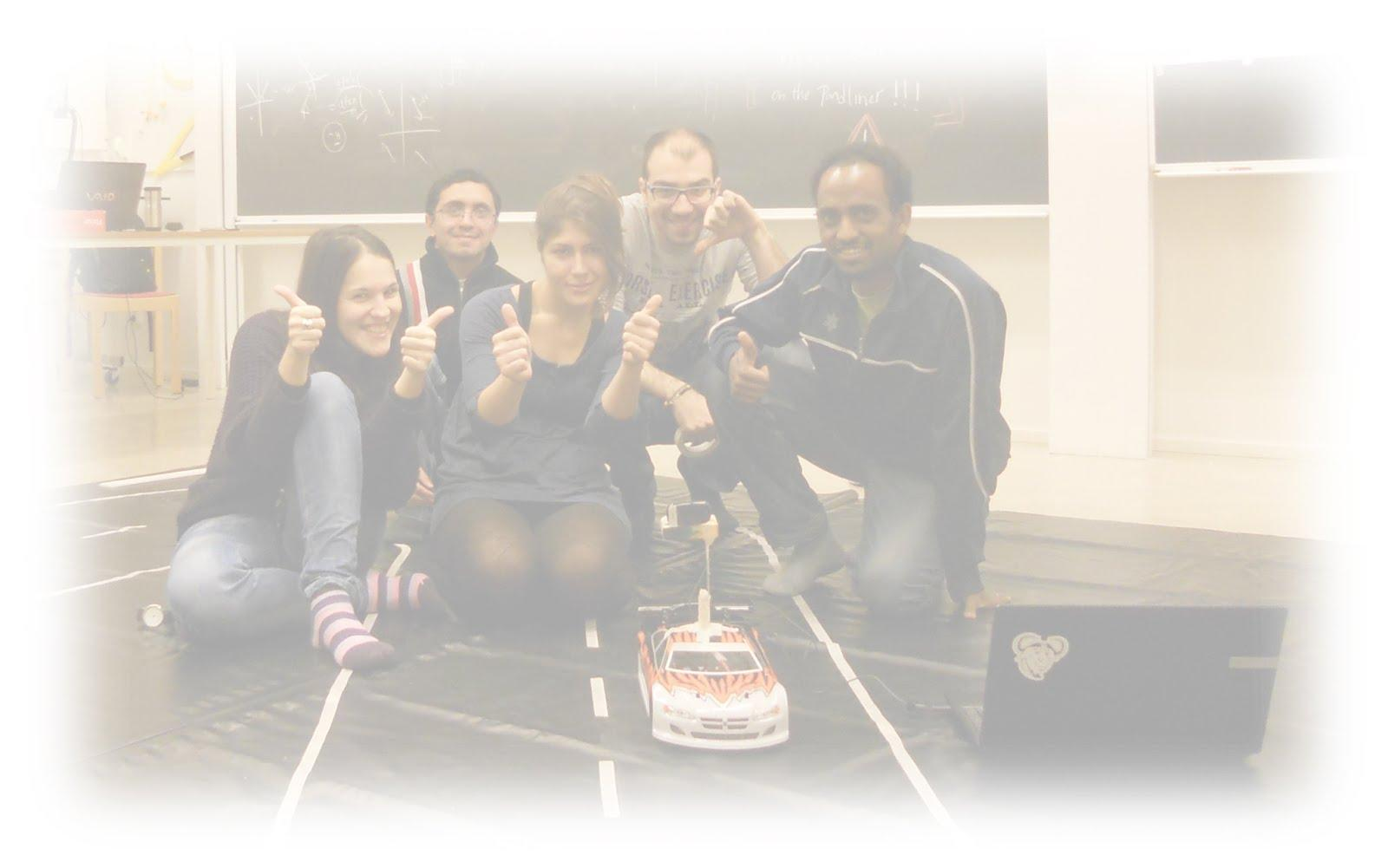
Hardware
- Based on discussion with Benjamin,
since a microcontroller is integrated
in the Motor controller board, there
is no need to install the discovery board.
- As the result of test shows, the best place for
the camera is in the back.
- The design and on the plastic board will be
finished on Thursday

Slide 7
Integration
Created a new lane detection file
customised the birds eye view
customised as input image the car's camera.
Mounted the camera on the vehicle.
Run this code using the laptop and the vehicle.
Problems:
Light reflection creates noise
Pond liner not stretched surface creates noise

Slide 8
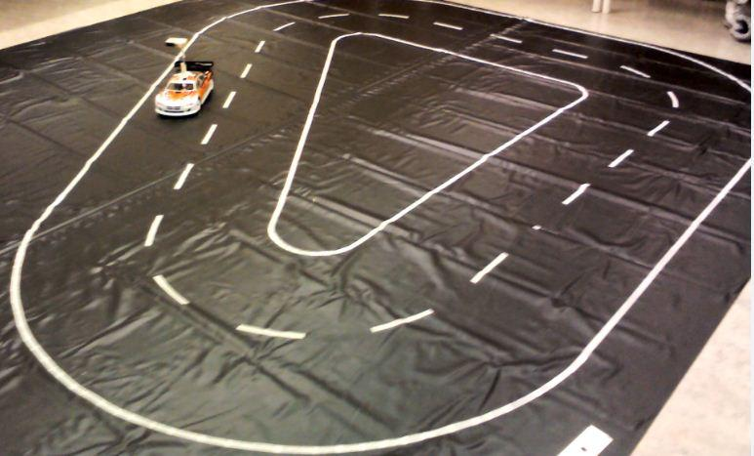
Track
0-4 mm deviation in some parts
Need to find a way to stretch the pond liner

Slide 9
Next week
line filtering - Kalman/...??
Finalise the Steering Method
- define the car turning angle dynamically
- reduce the line-covered area when approaching a curve
Get rid of the noise from the pond liner (physically/thresholding/...)

